Slide 1
Lab Work CPT-based Cs microcell Atomic Clock
Marion Delehaye, Clément Lacroûte, Cyrus Rocher, Gilles Martin, Philippe Abbé, Rodolphe Boudot

Slide 2

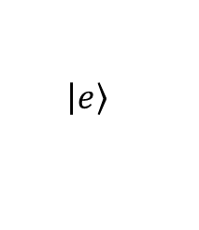
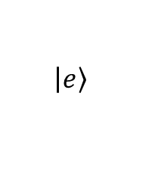
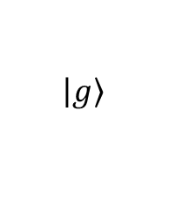
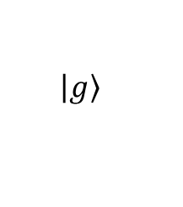


Reminder: Linear Spectroscopy (cf. Mileti, Lacroûte)
$$P_{L}$$
$$\left.\left|e\right.\right\rangle$$
Optical Absorption Medium
$$\left.\left|g\right.\right\rangle$$
$$ν_{L}$$
Very easy! Put a gas vapor in a glass cell!
Laser
Vapor cell
$$\left.\left|e\right.\right\rangle$$
500 MHz
The lines are broadened by the Doppler effect
F=2
$$\left.\left|g\right.\right\rangle$$
6.8 GHz
F=1

Slide 3

Reminder: CPT in cell clocks (cf Mileti, Affolderbach)
Coherent Population Trapping (CPT)
2 coherent light fields,
Simultaneous preparation and interrogation
Employs coherent laser effects ⇒ potential for new & improved clocks (first proposal: Cyr et al., IEEE TIM, 1993)
No microwave cavity needed ⇒ more radical clock miniaturization
P
2 light fields: f₁ – f₂ = f_{HFS} = f_{clock}
S
Laser source
Rb
cell
Det.
≤ 1 %
u-wave source
Servo
loop
transmission
f_{uwave}

Slide 4
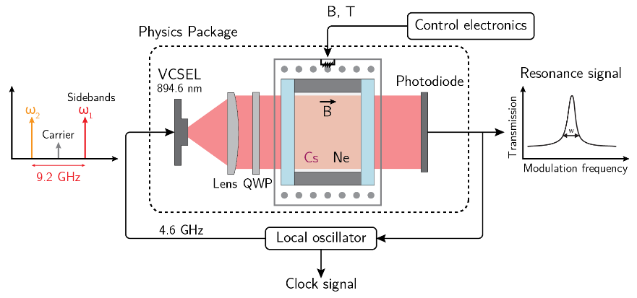
Lab work CPT clock
You will be able to control:
the VCSEL current and temperature
the magnetic field
the local oscillator frequency
the RF modulation power
You will be able to view:
the photodiode signal
laser and local oscillator error signals
the clock signal

Slide 5
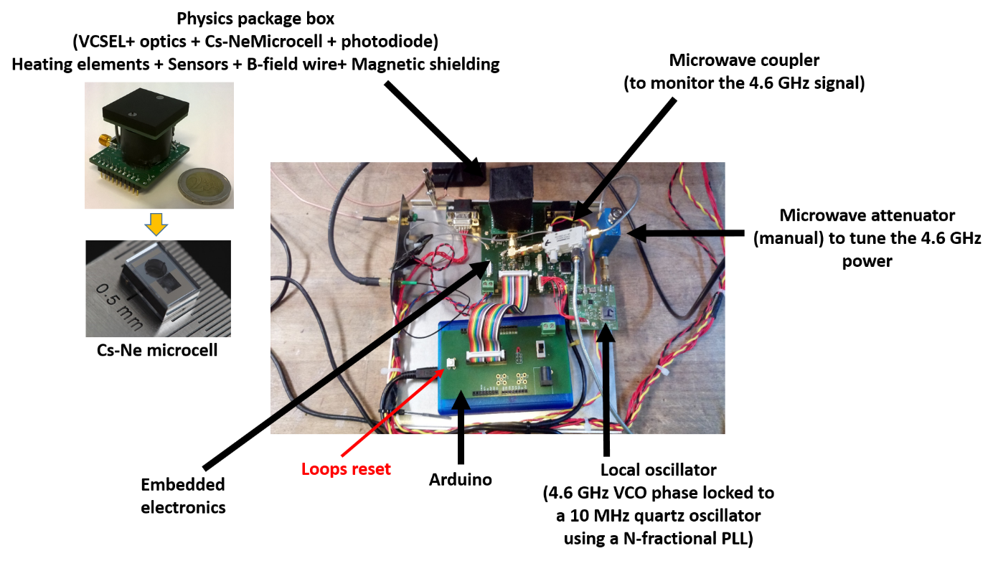
Lab work CPT clock – hardware

Slide 6
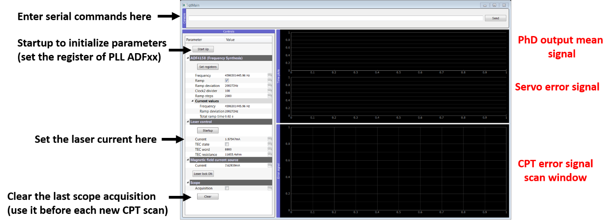
Lab work CPT clock – software
The whole experiment is controlled by an Arduino controller, interfaced using a C software and a Python interface.
The GUI lets you input the commands as digital words within the command line.
Some parameters (laser diode current, magnetic field current) can also be input in their proper unit in the dedicated boxes.
You can view the commands and digital words actually sent to the micro-controller in the command window

Slide 7
Lab work CPT clock – what you will do
1 – Characterize the laser diode
2 – Linear spectroscopy
3 – CPT signal
4 – Lock the LO using the CPT signal
5 – Characterize the clock frequency stability

Slide 8
You may now start the lab work… by reading the printed labwork subject!

Slide 9
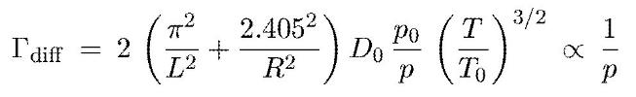

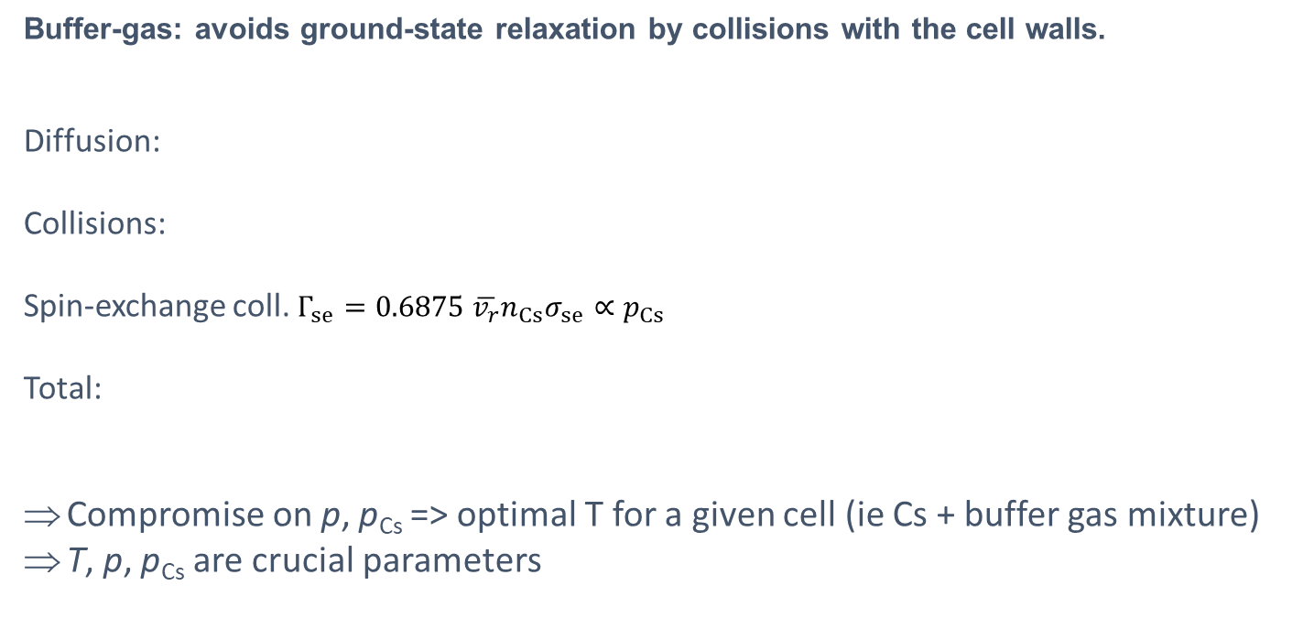

CPT linewidth – influence of collisions
Buffer-gas: avoids ground-state relaxation by collisions with the cell walls.
Diffusion:
Collisions:
Spin-exchange coll. $Γ_{se}=0.6875 \overline{v_{r}}n_{Cs}σ_{se}∝p_{Cs}$
Total:
Compromise on p, p_{Cs} => optimal T for a given cell (ie Cs + buffer gas mixture)
T, p, p_{Cs} are crucial parameters
Collisions with the walls
Cs
Collisions with the buffer gas
gas
Cs-Cs collisions
$${+ Γ}_{se}$$

Slide 10
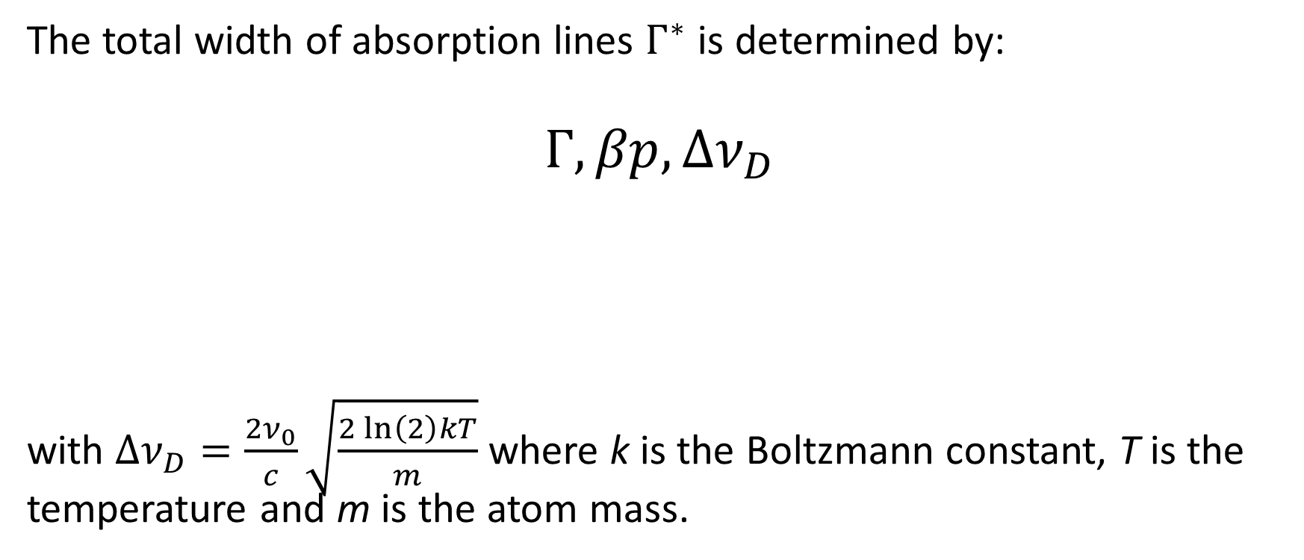
Linear absorption – linewidth
The total width of absorption lines $Γ^{∗}$ is determined by:
$$Γ, βp,Δν_{D}$$
with $Δν_{D}=\frac{2ν_{0}}{c}\sqrt{\frac{2\ln\left(2\right)kT}{m}}$ where k is the Boltzmann constant, T is the temperature and m is the atom mass.
Doppler width
Natural width
Collisional broadening
(MHz/Torr)
Pressure

Slide 11
Linear absorption – linewidth
The total width of absorption lines $Γ^{∗}$ is determined by:
$$Γ, βp,Δν_{D}$$
with $Δν_{D}=\frac{2ν_{0}}{c}\sqrt{\frac{2\ln\left(2\right)kT}{m}}$ where k is the Boltzmann constant, T is the temperature and m is the atom mass.
Approx. 360 MHz @295 K
4,56 MHz
Pressure
10-20 MHz/Torr

Slide 12
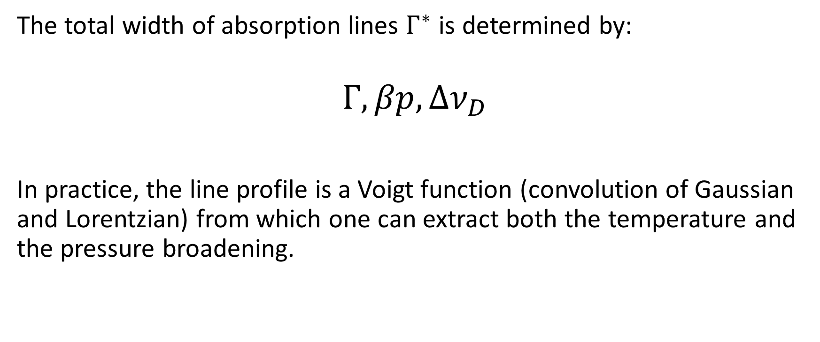
Linear absorption – linewidth
The total width of absorption lines $Γ^{∗}$ is determined by:
$$Γ, βp,Δν_{D}$$
In practice, the line profile is a Voigt function (convolution of Gaussian and Lorentzian) from which one can extract both the temperature and the pressure broadening.
Lorentzian
Gaussian

Slide 13


Linear absorption – linewidth
The total width of absorption lines $Γ^{∗}$ can be roughly approximated by:
$$Γ^{∗}≈\frac{Γ+βp}{2}+\sqrt{{{\left(Γ+βp\right)}^{2}}/4+ Δν_{D}^{2}}$$
From a fit, one could extract T and β or p.
Here, we know T and β so we can deduce p.
A better approximation (0.02% error – source Wikipedia):

Slide 14

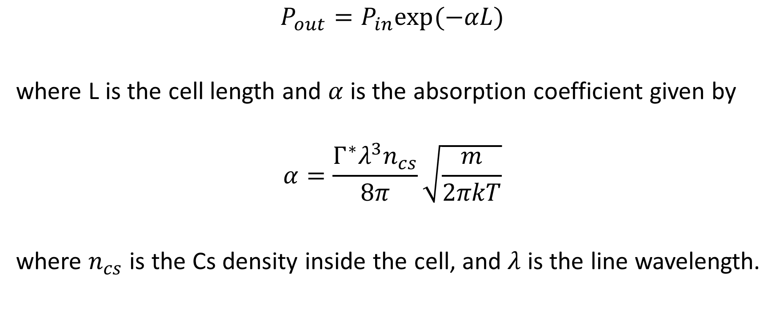

Linear absorption – Beer-Lambert law
$$P_{in}$$
Cs
$$P_{out}$$
$$P_{out}=P_{in}exp⁡(−αL)$$
where L is the cell length and $α$ is the absorption coefficient given by
$$α=\frac{Γ^{∗}λ^{3}n_{cs}}{8π}\sqrt{\frac{m}{2πkT}}$$
where $n_{cs}$ is the Cs density inside the cell, and $λ$ is the line wavelength.

Slide 15
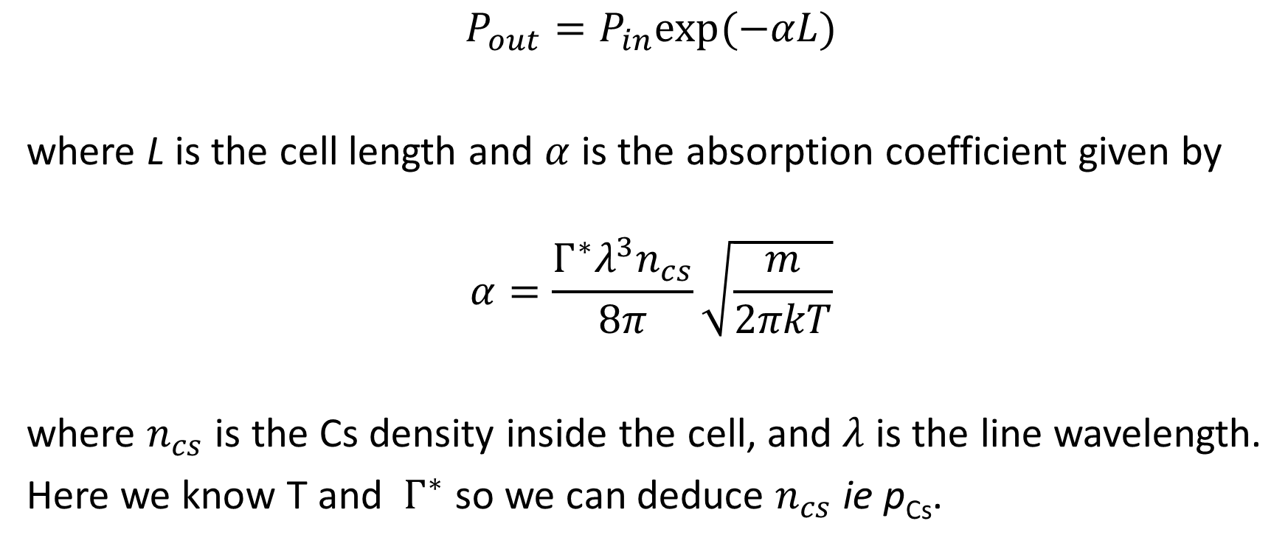
Linear absorption – Beer-Lambert law
$$P_{in}$$
Cs
$$P_{out}$$
$$P_{out}=P_{in}exp⁡(−αL)$$
where L is the cell length and $α$ is the absorption coefficient given by
$$α=\frac{Γ^{∗}λ^{3}n_{cs}}{8π}\sqrt{\frac{m}{2πkT}}$$
where $n_{cs}$ is the Cs density inside the cell, and $λ$ is the line wavelength.
Here we know T and $Γ^{∗}$ so we can deduce $n_{cs}$ie p_{Cs}.

Slide 16
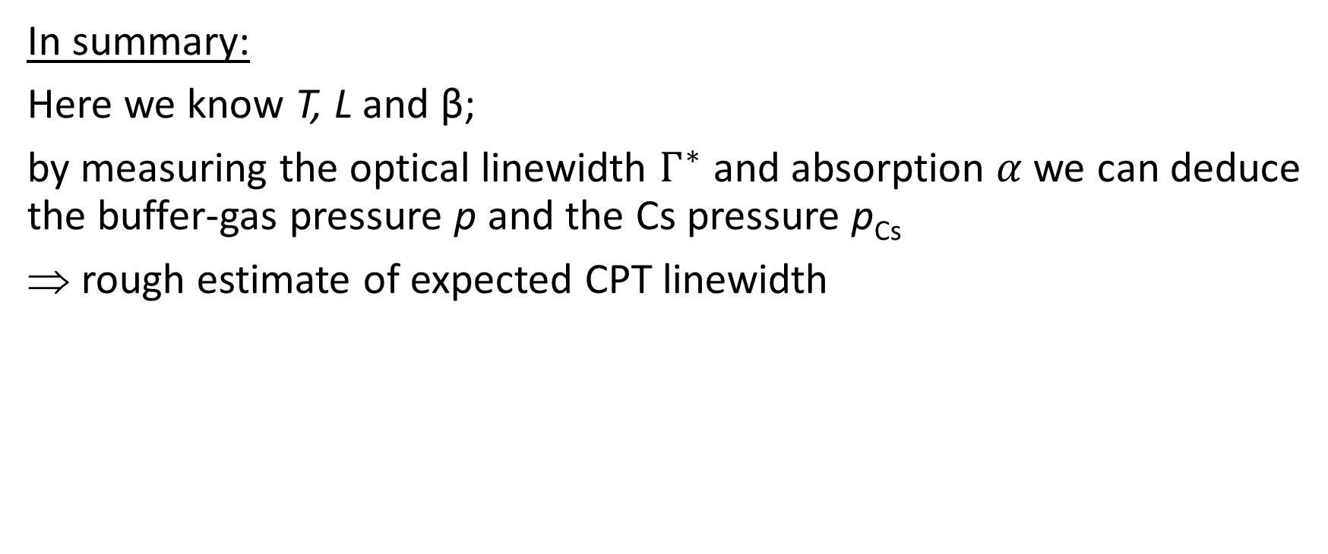
In summary:
Here we know T, L and β;
by measuring the optical linewidth $Γ^{∗}$ and absorption $α$we can deduce the buffer-gas pressure p and the Cs pressure p_{Cs}
rough estimate of expected CPT linewidth

